Slide 1
Pizza Sales Report
Presented By –
Anik Dey

Slide 2


Contents of this template
Here’s what you’ll find in this template:
Objective
Steps Performed
KPIs
Treemap
Slicer
Graphs

Slide 3

Agenda
PIZZAS
Import data into Power BI
Data Transformation
Data Modelling
Dax Query
Total Orders
Total Pizza sold
Total Revenue
Avg. Order value
Avg. Pizza per Order
Analysis from the data set
Best & Worst Sellers

Slide 4
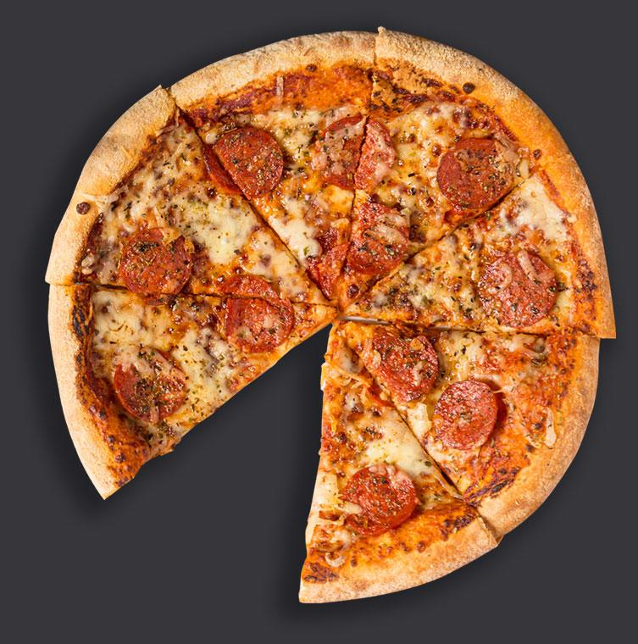

Project Objective
To determine peak hours and examine consumer traffic patterns in order to maximize manpower and boost operational effectiveness.
To determine the most popular pizzas and the average quantity of pizzas ordered so that marketing and inventory management tactics can be adjusted accordingly.
To calculate the total amount of money made from pizza sales over the course of the year and spot any seasonal patterns to help with budgeting and forecasting.
To evaluate the popularity of different pizzas on the menu and find out whether ones are underperforming or have room for promotion in order to maximize the menu and boost sales.

Slide 5


Steps Performed
1
Import csv data into Power BI.
Data Modelling
Data Transformation
2
Dax Query
Total Revenue = Sum of Total price
Total Orders = Distinctcount Order id
Total Pizza sold = Sum of Quantity
Average Order Value = Total Revenue / Total Orders
Average Pizza per Order = Total Pizza sold / Total Orders.
From the order_date data, I have created new column of “Day Name” & “Day number”, to find the Total Orders on those individual days.

Slide 6

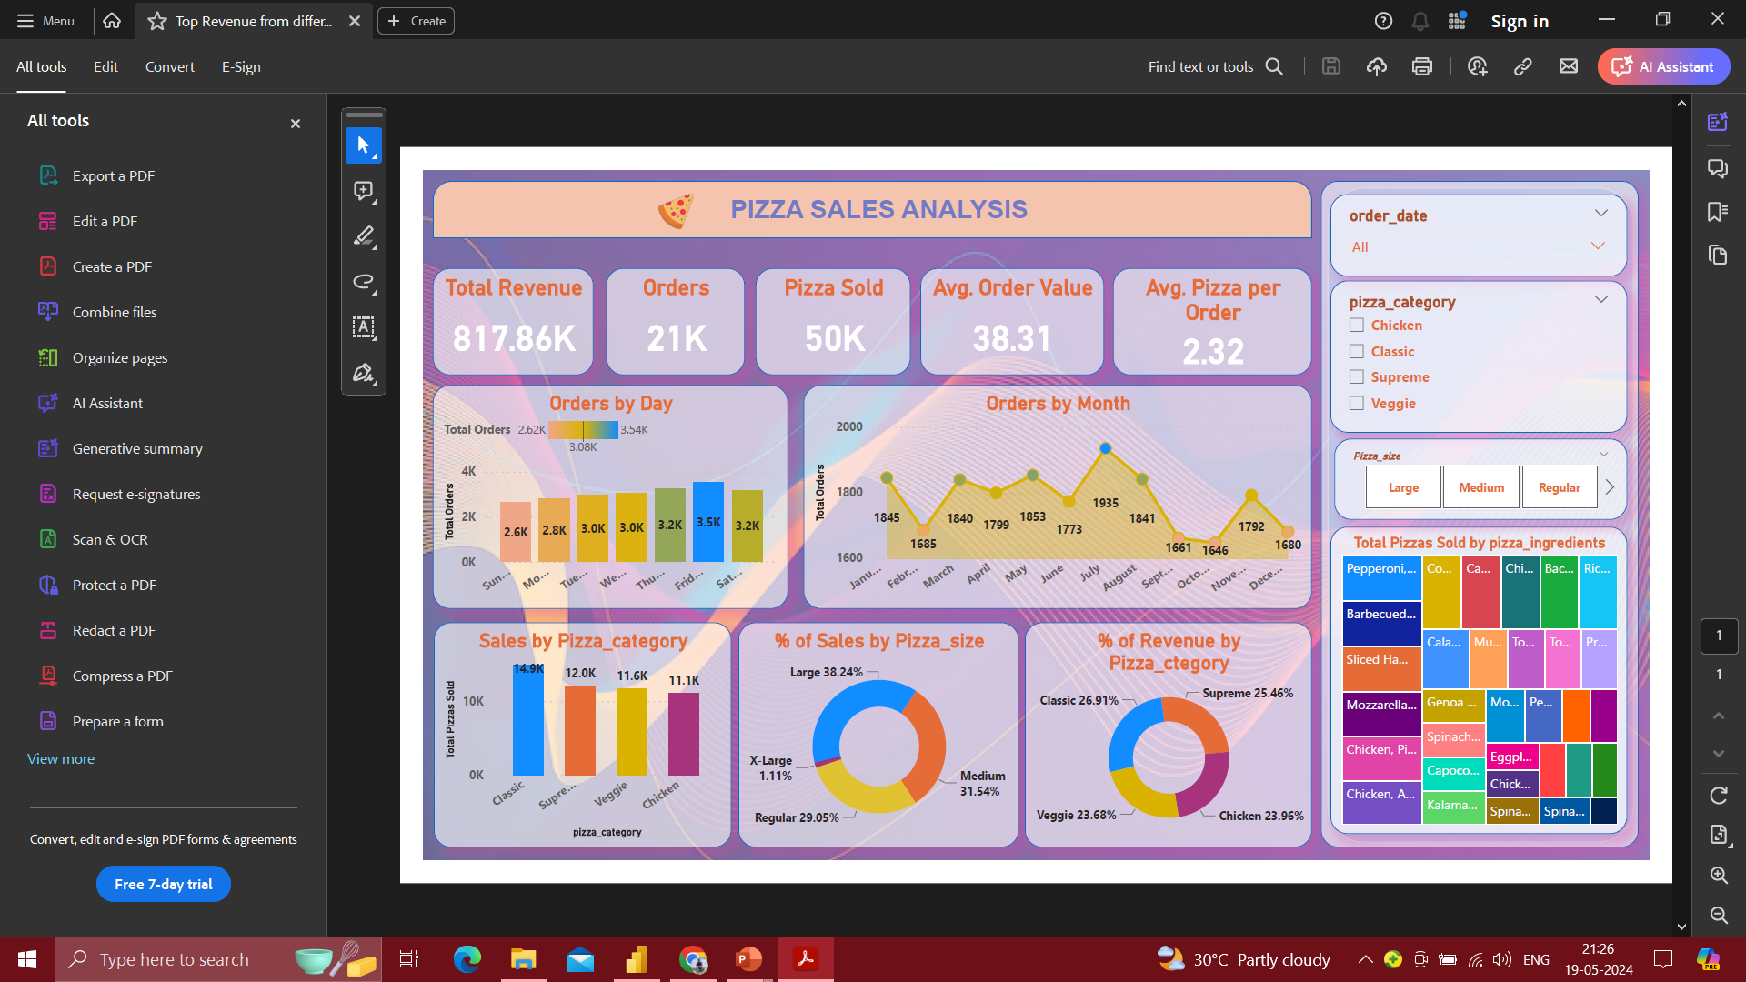


Top Revenue from different pizza category & Size

Slide 7
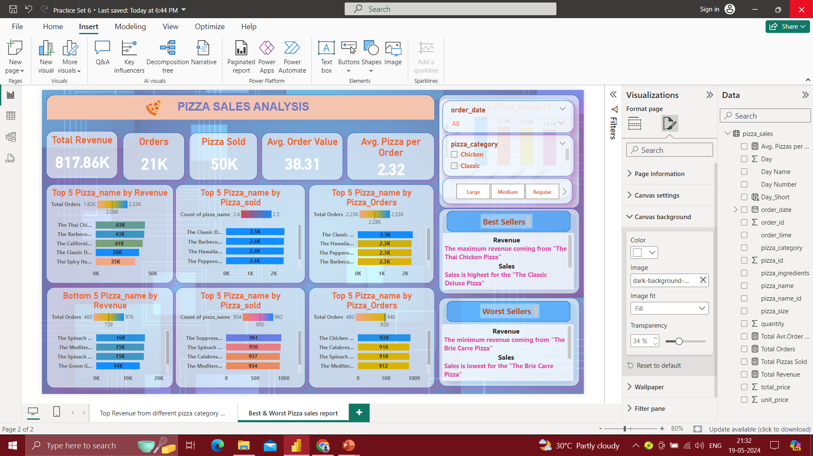
Best & Worst Pizza Sales Report

Slide 8

Report Analysis
I have attached 5 KPIs on the dashboard. Those are –
Total revenue, Orders, Pizza sold, Avg. Order value, and Avg. Pizza per order
The values of those KPIs will be changed with the change in the order_date, pizza_category and pizza_order present on the slicer.
Orders by Day – This makes it clear that Friday orders are higher than those on Thursday and Saturday, Tuesday is higher than those on Thursday, and so on.
Orders by Month – This allows us to see the total orders for each month. July has the most orders, followed by May, and so forth.
Sales by Pizza_category – Here, we can see an overview of the overall sales of pizza broken down by category. The order date, pizza type, and pizza size will modify this data.
% Sales by Pizza_size – We can now recognize the overall percentage of sales by pizza_sizes. Large size sales percentage is higher than medium and so forth.
% of Revenue by Pizza_category – It is easy to see that the "Classic" pizza category generates the most revenue, followed by "Supreme," and so on.
Additionally, I've included a treemap that shows the total amount of pizza sold by Pizza Ingredients.
The order_date, pizza_category, and pizza_size will be altered as per the stated changes in this treemap, which will also display the ingredients used in the delivered pizzas.

Slide 9

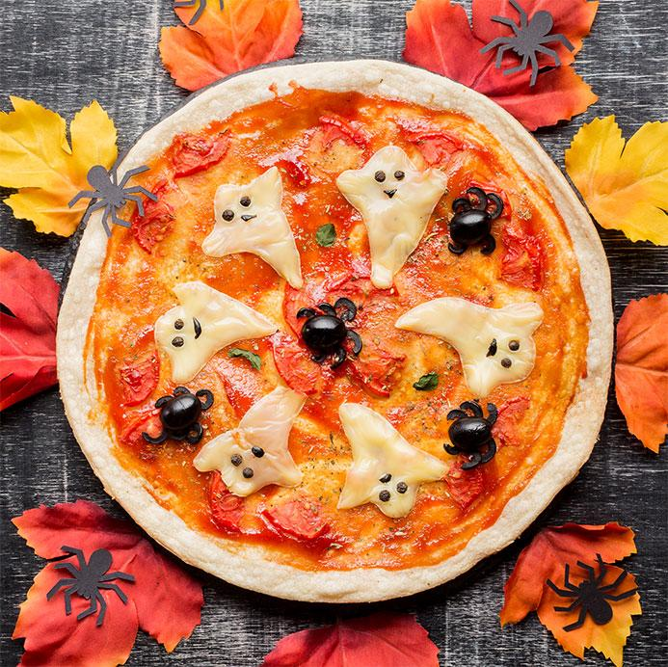
Pizza of love
Thank You

